Slide 1
Udacity Connect Session
May 12, 2018
Deep Learning - CNN
Augmentation and Transfer Learning

Slide 2
Welcome back!

Slide 3
Morning Schedule
10:00 - 10:30 | Housekeeping, Review
10:30 - 11:00 | Augmentation and CNN Visualizations
11:00 - 11:30 | Notebook Session
11:30 - noon | Notebook Discussion
© 2016 Udacity. All rights reserved.

Slide 4
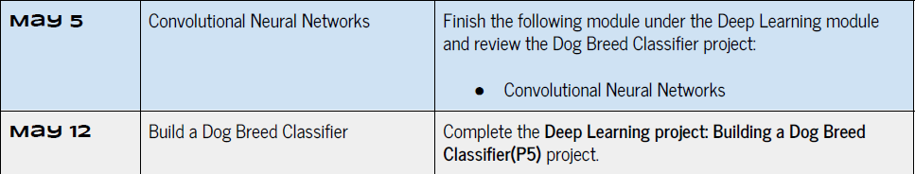

Slide 5
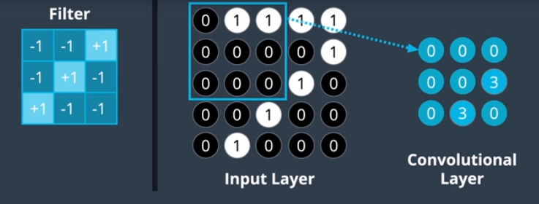
RELU ( SUM ( W * x ) )

Slide 6
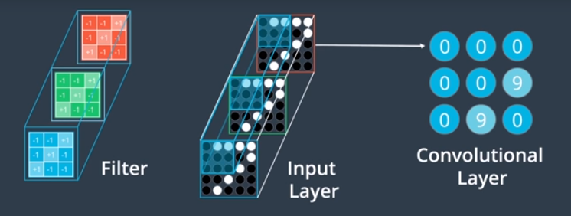

Slide 7
test
Convolutional Filter
Kernel Size
Very commonly 3x3
Stride
How many pixels to shift (typically 1)
Padding (dealing with edges)
“Valid” - stay within original image boundaries
“Same” - pad with zeros

Slide 8
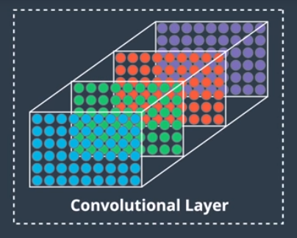

Slide 9
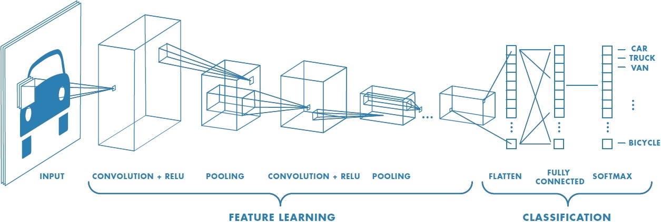
CNN Architecture

Slide 10
Parameters
padding=’same’
Sequential() input_shape=(32, 32, 3)
.add(Conv2D(filters=16, kernel_size=2,,..)
.add(Conv2D(filters=32, kernel_size=2, ..))
.add(MaxPooling2D(pool_size=2))
.add(Conv2D(filters=64, kernel_size=2, ..))
.add(MaxPooling2D(pool_size=2))
(32, 32, 16) 208
(32, 32, 32) 2080
(16, 16, 32)
(8, 8, 64) 8256
(4, 4, 64)
Notes:
Quiz
.add(Conv2D(filters=16, kernel_size=2,,..)
Output = 32 x 32 x 16
(1+4x3)x16 = 208
.add(Conv2D(filters=32, kernel_size=2, ..))
Output = 32 x 32 x 32 (fillers)
Weights = (1+4x16)x32 = 2080
.add(MaxPooling2D(pool_size=2))
.add(Conv2D(filters=64, kernel_size=2, ..))
.add(MaxPooling2D(pool_size=2))

Slide 11
Augmentation
https://keras.io/preprocessing/image/
from keras.preprocessing.image import ImageDataGenerator datagen = ImageDataGenerator( rotation_range=40, width_shift_range=0.2, height_shift_range=0.2, rescale=1./255, shear_range=0.2, zoom_range=0.2, horizontal_flip=True, fill_mode='nearest')

Slide 12
Training with Augmentation
Normal
Augmentation
create training set
X_train = ..
[ create validation set ]
model = Sequential().add( .. )
model.compile( .. )
model.fit(..)
model.predict( .. )
create training set generator
gen_train = ImageDataGenerator..
gen_train.fit(X_train)
[ create validation set generator ]
model = Sequential().add( .. )
model.compile( .. )
model.fit_generator(datagen_train.flow(..), ..)
model.predict( .. )

Slide 13
VISUALIZING CNN FILTERS
http://cs231n.github.io/understanding-cnn/
Layer activations
Visualize weights
Deconvolutional Networks

Slide 14
zkhundkar/ConnectIntensive/
cifar10/CNN Visualization
cifar10/CNN Augmentation

Slide 15
Lunch Break

Slide 16
Afternoon Session
1:00 - 2:00 | Transfer Learning
2:00 - 2:30 | Notebook session
2:30 - 2:50 | Notebook Review/Proposal
2:50 - 3:00 | Recap, Lookahead and Feedback
3:00 - 5:00 | Work on Projects (P4 or P5)
© 2016 Udacity. All rights reserved.

Slide 17
CNN Architecture

Slide 18
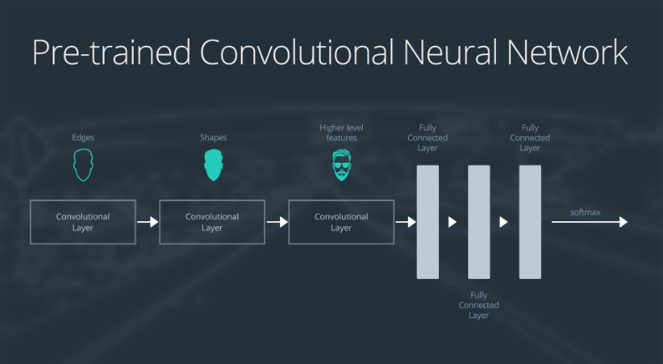
Softmax
Edges
Shapes
Complex Features
FC (Dense) Layers

Slide 19
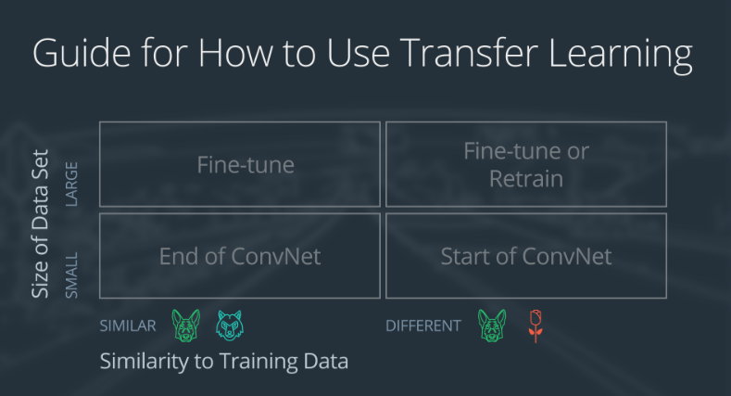

Slide 20
Small data set, similar to original training data
slice off the end of the neural network
add a new fully connected layer that matches the number of classes in the new data set
randomize the weights of the new fully connected layer; freeze all the weights from the pre-trained network
train the network to update the weights of the new fully connected layer

Slide 21
Small dataset similar to training data
Extract
Retrain
Softmax
Edges
Shapes
Complex Features
FC (Dense) Layers

Slide 22
Small data set, not similar to original training data
slice off most of the pre-trained layers near the beginning of the network
add to the remaining pre-trained layers a new fully connected layer that matches the number of classes in the new data set
randomize the weights of the new fully connected layer; freeze all the weights from the pre-trained network
train the network to update the weights of the new fully connected layer

Slide 23
Small dataset NOT similar to training data
Extract
Retrain
Softmax
Edges
Shapes
Complex Features
FC (Dense) Layers

Slide 24
Small data set, not similar to original training data
remove the last fully connected layer and replace with a layer matching the number of classes in the new data set
randomly initialize the weights in the new fully connected layer
initialize the rest of the weights using the pre-trained weights
re-train the entire neural network

Slide 25
Large dataset similar to training data
Same architecture, use pre-computed weights as initial values
Random Init weights
Softmax
Retrain full network
Edges
Shapes
Complex Features
FC (Dense) Layers

Slide 27
Udacity/machine-learning/projects
/practice_projects/cnn/transfer-learning
/bottleneck_features
/transfer_learning

Slide 28
Prep for next week
Complete Smartcab Project (P4) due 4/28/18
Submit/complete Dog Breed Project (P5) due 5/19/18
Research ideas for capstone project

Slide 29
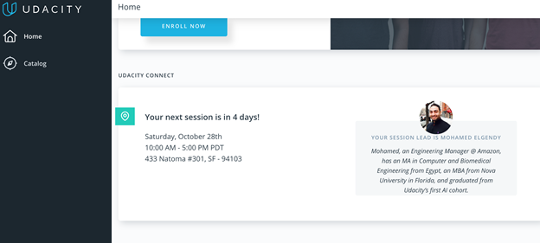
We really need your Feedback!
© 2016 Udacity. All rights reserved.

